Slide 1
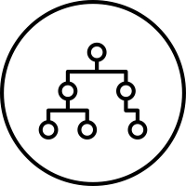
Mapping Techniques for Load
Balancing
UZAIR WAHEED ANJUM MAHROSE FATIMA

Slide 2
Mapping Techniques for Load Balancing
In order to achieve a small execution time, the overheads of executing the tasks in parallel must be minimized.
For a given decomposition, there are two key sources of overhead.
The time spent in inter-process interaction is one source of overhead.
The time that some processes may spend being idle.
Therefore, a good mapping of tasks onto processes must strive to achieve the twin objectives of
(1) reducing the amount of time processes spend in interacting with each other, and
(2) reducing the total amount of time some processes are idle while the others are engaged in performing some tasks

Slide 3
Mapping Techniques for Load Balancing
In this section, we will discuss various schemes for mapping tasks onto processes with the primary view of balancing the task workload of processes and minimizing their idle time.
A good mapping must ensure that the computations and interactions among processes at each stage of the execution of the parallel algorithm are well balanced.

Slide 4
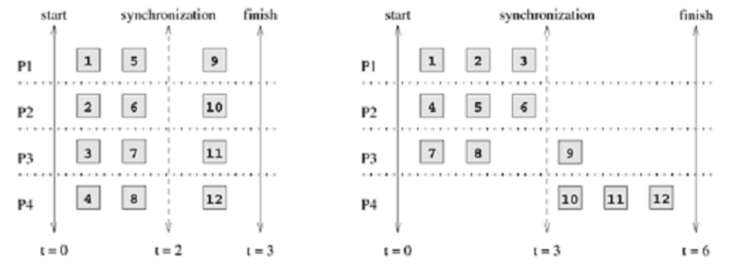
Mapping Techniques for Load Balancing
• Two mappings of a hypothetical decomposition with a synchronization

Slide 5
Mapping Techniques for Load Balancing
Mapping techniques used in parallel algorithms can be broadly classified into two categories
Static
Static mapping techniques distribute the tasks among processes prior to the execution of the algorithm.
For statically generated tasks, either static or dynamic mapping can be used.
Algorithms that make use of static mapping are in general easier to design and program.
Dynamic
Dynamic mapping techniques distribute the work among processes during the execution of the algorithm.
If tasks are generated dynamically, then they must be mapped dynamically too.
Algorithms that require dynamic mapping are usually more complicated, particularly in the message-passing programming paradigm.

Slide 6
Mapping Techniques for Load Balancing More about static and dynamic mapping
If task sizes are unknown, then a static mapping can potentially lead to serious load-imbalances and dynamic mappings are usually more effective.
If the amount of data associated with tasks is large relative to the computation, then a dynamic mapping may entail moving this data among processes. The cost of this data movement may outweigh some other advantages of dynamic mapping and may render a static mapping more suitable.

Slide 7
Schemes for Static Mapping • Mappings Based on Data Partitioning
Array Distribution Schemes
Block Distributions
Cyclic and Block-Cyclic Distributions
Randomized Block Distributions
Graph Partitioning
Mappings Based on Task Partitioning
Hierarchical Mappings

Slide 8
Mappings Based on Data Partitioning
The data-partitioning actually induces a decomposition, but the partitioning or the decomposition is selected with the final mapping in mind.
Array Distribution Schemes
We now study some commonly used techniques of distributing arrays or matrices among processes.

Slide 9
Array Distribution Schemes: Block
Distributions
Block distributions are some of the simplest ways to distribute an array and assign uniform contiguous portions of the array to different processes.
Block distributions of arrays are particularly suitable when there is a locality of interaction, i.e., computation of an element of an array requires other nearby elements in the array.

Slide 10
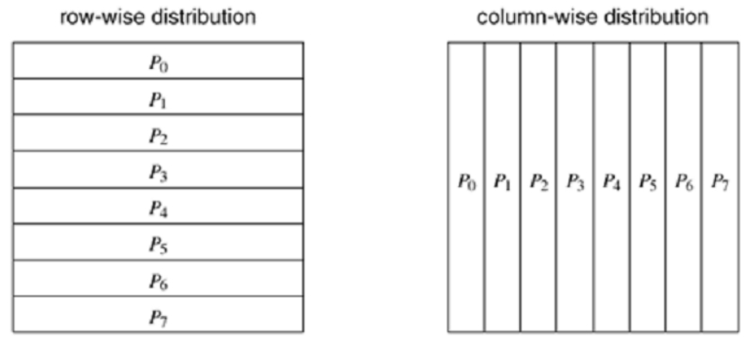
Array Distribution Schemes: Block
Distributions
• Examples of one-dimensional partitioning of an array among eight processes.

Slide 11
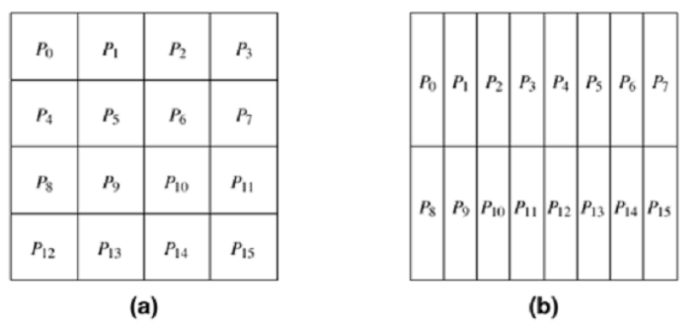
Array Distribution Schemes: Block
Distributions
• Examples of two-dimensional distributions of an array, (a) on a 4 x 4 process grid, and (b) on a 2 x 8 process grid.

Slide 12
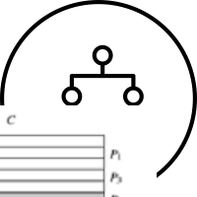
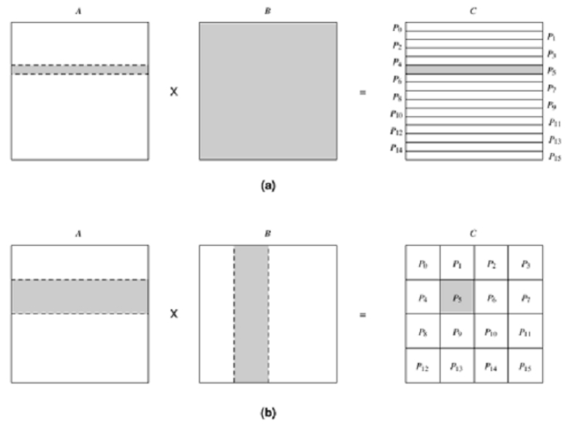
Array Distribution Schemes: Block
Distributions
• Data sharing needed
for matrix
multiplication with
(a) one-dimensional
and (b) two-
dimensional
partitioning of the
output matrix.
Shaded portions of
the input matrices A
and B are required
by the process that
computes the
C.

Slide 13
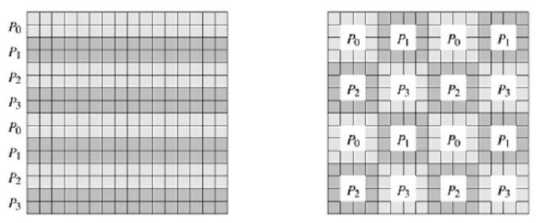
Array Distribution Schemes: Block-cyclic
distribution
• The block-cyclic
distribution is a variation
of the block distribution
scheme that can be used
to alleviate the load-
imbalance and idling
problems.
• Examples of one- and
two-dimensional block-
cyclic distributions
among four processes.

Slide 14
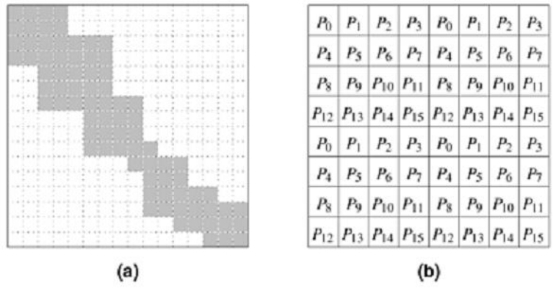
rray Distribution Schemes: Randomized
lock Distributions
• Using the block-cyclic distribution shown in (b) to distribute the computations performed in array (a) will lead to load imbalances.

Slide 15
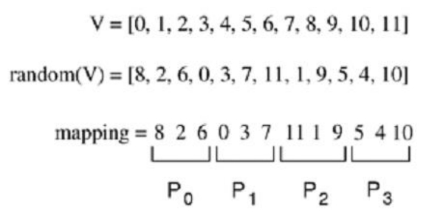
rray Distribution Schemes: Randomized
lock Distributions
• A one-dimensional randomized block mapping of 12 blocks onto four process

Slide 16
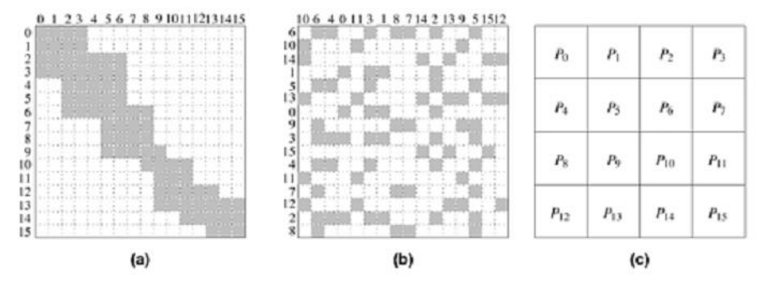
rray Distribution Schemes: Randomized
lock Distributions
• Using a two-dimensional random block distribution shown in (b) to distribute the computations performed in array (a), as shown in (c).

Slide 17
Graph Partitioning
There are many algorithms that operate on sparse data structures and for which the pattern of interaction among data elements is data dependent and highly irregular.
Numerical simulations of physical phenomena provide a large source of such type of computations.
In these computations, the physical domain is discretized and represented by a mesh of elements.
The simulation of the physical phenomenon being modeled then involves computing the values of certain physical quantities at each mesh point.
The computation at a mesh point usually requires data corresponding to that mesh point and to the points that are adjacent to it in the mesh

Slide 18
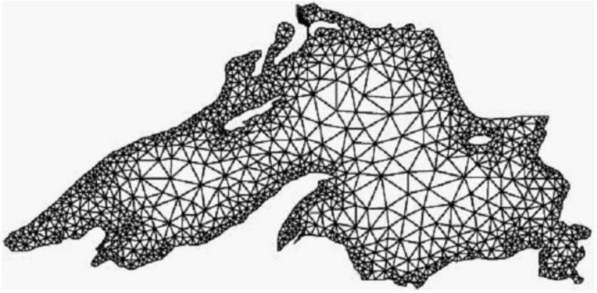
Graph Partitioning
A mesh used to model Lake Superior

Slide 19
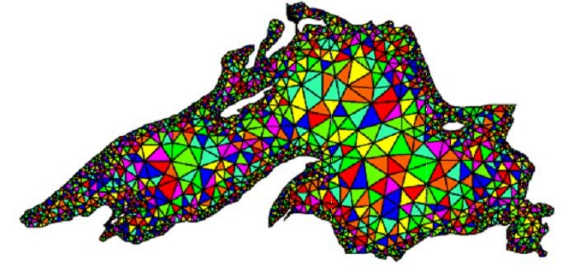
Graph Partitioning
• A random distribution of the mesh elements to eight processes.
Each process will need to access a large set of points belonging to other processes to complete computations for its assigned portion of the mesh

Slide 20
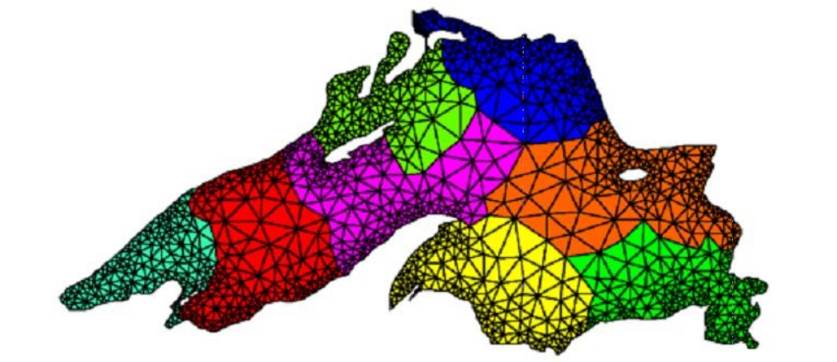
Graph Partitioning
• A distribution of the mesh elements to eight processes, by using a graph-partitioning algorithm.

Slide 21
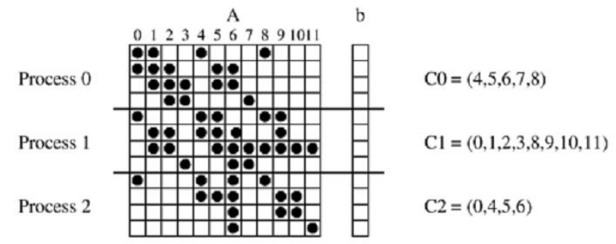
Mappings Based on Task Partitioning
• As a simple example of a mapping based on task partitioning,
consider a task-dependency graph that is a perfect binary tree.
• Such a task-dependency graph can occur in practical problems with recursive decomposition, such as the decomposition for finding the minimum of a list of numbers.
A mapping for
sparse matrix-vector
multiplication onto
three processes. The
list Ci contains the
indices of b that
Process i needs to
access from other
processes.

Slide 22
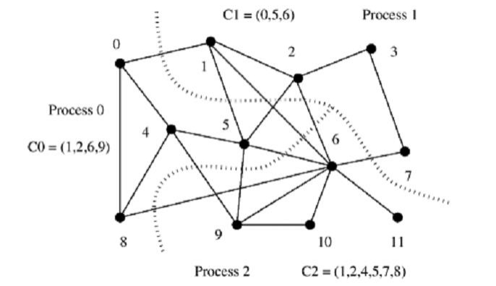
Mappings Based on Task Partitioning
• Reducing interaction overhead in sparse matrix-vector multiplication by partitioning the task-interaction graph

Slide 23
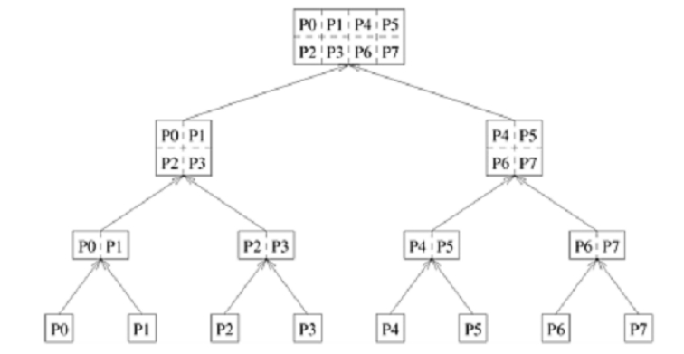
Hierarchical Mappings
• An example of
hierarchical mapping
of a task-dependency
graph. Each node
represented by an
array is a supertask.
The partitioning of
the arrays represents
subtasks, which are
mapped onto eight
processes.

Slide 24
Schemes for Dynamic Mapping
The primary reason for using a dynamic mapping is balancing the workload among processes, dynamic mapping is often referred to as dynamic load-balancing.
Dynamic mapping techniques are usually classified as either
Centralized Schemes or
Distributed Schemes

Slide 25
Centralized Schemes
All executable tasks are maintained in a common central data structure or they are maintained by a special process or a subset of processes.
If a special process is designated to manage the pool of available tasks, then it is often referred to as the master and the other processes that depend on the master to obtain work are referred to as slaves.

Slide 26
Distributed Schemes
In a distributed dynamic load balancing scheme, the set of executable tasks are distributed among processes which exchange tasks at run time to balance work.
Each process can send work to or receive work from any other process.
Some of the critical parameters of a distributed load balancing scheme are as follows:
How are the sending and receiving processes paired together?
Is the work transfer initiated by the sender or the receiver?
How much work is transferred in each exchange?
When is the work transfer performed?

